Slide 1
New Mexico Environment Department
New Mexico’s Water Challenges
Including the impacts of the Sackett vs. USEPA Decision
John Rhoderick, Director
Water Protection Division
September 13, 2023

Slide 2
Water Challenges in Our High Desert Paradise

Slide 3
Natural Challenges
Extended Intense Drought Conditions.
Drought
Wildfires
Flooding
Diminishing fresh water sources
Notes:
Climate Change is a contributing factor to intensity of some natural disasters.
Human incursion and growth result in expanded human-natural environment interface.
Human interference with natural processes.

Slide 4
Man Made Challenges
Poorly maintained water and wastewater systems.
Improper operation of water and wastewater systems.
Lack of appropriately trained operators.
Expanding residential and commercial growth increasing consumption.
Water management.
Regulatory uncertainty.

Slide 5
How Do We Address the Challenges?
Development of Water Reuse Regulations to include:
Direct and Indirect Potable Reuse.
Expanded Reclaimed Wastewater Use.
Commercial Gray Water Use.
Treated Produced Water Industrial Reuse.
Brackish Water (Desalination).
Direct Aquifer Recharge.

Slide 6
How Do We Address the Challenges?
Protecting Existing Surface and Ground Water Sources.
Development of a New Mexico Surface Water Permitting System.
Enhancement of Groundwater Protection Regulations.
Develop training programs for utility operators and work with communities to be able to hire.
Water and Wastewater System Regionalization.

Slide 7
Addressing Regulatory Uncertainty
In 1972, the Clean Water Act
(CWA) made it illegal to discharge pollutants into “waters of the United States,” or
WOTUS, without a permit.
"Waters of the US" refers to waters that are protected under the federal Clean Water Act.
Over time, Supreme Court decisions established that the definition of “waters of the U.S.” is more than traditional navigable waters, but less than all waters.

Slide 8
WOTUS – USEPA Rulemakings
2015 = Obama-era Clean Water Rule emphasized Kennedy’s “significant nexus” test.
2020 = Trump-era Navigable Waters Protection Rule emphasized Scalia’s “relatively permanent” test.
2021 = Biden-era WOTUS Rule to re-codify pre-2015 definition updated to consider Supreme Court decisions (incl. relatively permanent and significant nexus tests).
2022 = Supreme Court hears Sackett v. EPA

Slide 9
Sackett Decision
2023 = Supreme Court decision in Sackett case – emphasizes Scalia’s “relatively permanent” test.
The Court held that the CWA applies only to wetlands that are "as a practical matter indistinguishable from waters of the United States."
Therefore, the party that wants the CWA to apply to adjacent wetlands must show that the adjacent body of water is a "water of the United States" -- that is, "a relatively permanent body of water connected to traditional interstate navigable waters" -- and that the wetland "has a continuous surface connection with that water, making it difficult to determine where the 'water' ends, and the 'wetland' begins".
Notes:
Requires a visible surface connection between a protected water and a wetland making it indistinguishable from the protected water.
The SCOTUS ruling was for a specific case where a private landowner (Sackett) wanted to fill in a wetland on the property to allow construction of a home. While ruling was specific to this case, it sets a precedent for similar situations and has caused EPA and the Army Corps of Engineers to re-evaluate the application across the nation.
There have been no immediate reactions on the part of permitee’s due to the ruling.

Slide 10
What Does Sackett vs EPA mean for New Mexico?
New Mexico Surface Water Landscape
Approximately 7% of New Mexico’s surface waters are perennial.
Nonperennial waters make up 93% of NM’s surface waters (88,810 miles out of 95,172 total miles).
In addition, many perennial streams and rivers are interrupted and therefore may not be subject to CWA protections under this new ruling. These include:
Many source waters for drinking water
All ephemeral waterbodies.
Without a surface water quality permitting program, New Mexico cannot fully protect its waters from contamination and degradation.
Notes:
NMED began working on development of a state surface water permitting program and primacy for EPA’s National Pollutant Discharge Elimination System permitting program in 2019 – 2020.
Perennial – Surface water that persists throughout the year.
Non-perennial or Ephemeral waters – Temporary streams where surface flows cease during dry periods.

Slide 11
WOTUS Protected Waters
Perennial vs. Non-Perennial
New Mexico
Perennial – 6,362 miles (appr. 7%)
Non-Perenial – 88,810 miles (Appr. 93%)
Total stream/river miles – 95,172

Slide 12
New Mexico Wetland Factoids
Wetlands cover about 482,000 acres (0.6 percent) of New Mexico, a reduction of about 33 percent from the wetland acreage that existed about 200 years ago (Dahl, 1990).
New Mexico's wetland acreage places the State 34th in total wetland acreage among the 48 conterminous States. Wetlands are ecologically important and economically valuable to the State.
Wetlands provide important wildlife habitat. For example, in the Rio Grande Valley, wetlands provide habitat for 246 species of birds, 10 species of amphibians, 38 species of reptiles, and 60 species of mammals (U.S. Fish and Wildlife Service, 1990).
Wetlands also provide stopover, feeding, and breeding grounds for migratory waterfowl (fig. 1). Riparian (streamside) wetlands along perennial streams are important as migration corridors for a variety of waterfowl and other wildlife.
The playa lakes in eastern New Mexico are vital links in a chain of wetlands along the Central Flyway, which extends from central Canada to the coast of Texas. Areas of springs and marshes provide essential habitat for many rare and endangered species and for indigenous fish and wildlife in the western part of the State.
Wetlands contribute to flood attenuation, bank stabilization, and improved water quality. New Mexico's tourist industry benefits from the beauty of the State's diverse wetlands. These wetlands provide opportunities for recreational activities that include fishing, hunting, bird watching, nature photography, camping, and hiking.

Slide 13
Surface Water Factoids
Approximately 40% of New Mexico’s population depends on surface water for its drinking water.
Approximately 45% of assessed (perennial) surface waters do not meet water quality standards.
Non-perennial waters are ecologically and hydrologically significant in the arid and semi-arid Southwest.
There is only a fixed amount of freshwater –less than 1% of all water on Earth is actually available for human use.
A spilled gallon of gasoline can contaminate 750,000 gallons of water.
Compared to today, five times as much land is likely to be under extreme drought by 2050.

Slide 14
What is NMED Doing to Respond?
June 22, 2023 NMED issued a Notice of potential state regulatory impacts resulting from the U.S. Supreme Court Sackett v. U.S. Environmental Protection Agency (EPA) decision https://www.env.nm.gov/wp-content/uploads/2023/06/2023-06-22-NMED-Notice-Regarding-Sackett-Decision.pdf
Surface Water Quality Bureau actively engaged in developing a State Surface Water Permitting Program. Approximately 2 years to regulations and approximately 7 years to become fully operational program. Also developing a Wetlands Protection program concurrently with the Surface Water Permitting Program.
State Program vs Primacy – Primacy (taking over jurisdiction from EPA for WOTUS) will not expand protection over Waters of the State. SWQB will be working to obtain primacy concurrently with implementing the state program.
Ground Water regulations prohibit any discharge that adversely impacts ground or surface water in the state.
NMED Rulemaking and other activities:
  Water Reuse Regulations
  Surface Water Permitting Program and Regulations
  Regionalization for Water and Wastewater Systems
  System Resiliency
  Emerging Contaminants
Notes:
Sliver City WWTP discharge permit is an example of using the ground water regs in a closed basin where there is no WOTUS designation by including conditions in the permit that mirror what would be required under an NPDES permit.
Ground water regulations are reactive to spills, releases, etc.

Slide 15
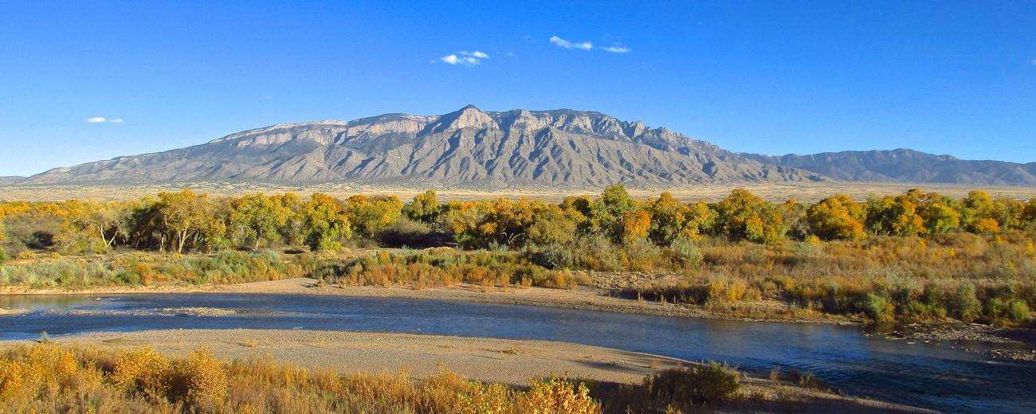
Questions?

Slide 16
Contact Information
John Rhoderick, Director
Water Protection Division
New Mexico Environment Department
John.Rhoderick@env.nm.gov
Shelly Lemon, Bureau Chief
Surface Water Quality Bureau
Water Protection Division
New Mexico Environment Department
Shelly.lemon@env.nm.gov
Justin Ball, Bureau Chief
Ground Water Quality Bureau
New Mexico Environment Department
Justin.ball@env.nm.gov
Christal Weatherly, Assistant General Counsel
Office of General Counsel
New Mexico Environment Department
Christal.weatherly@env.nm.gov

