Slide 1
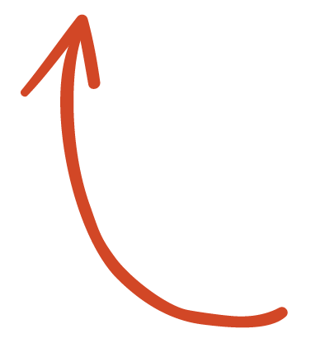
Here's your outline to get started
Key facts about your topic
In the United States, Election Day is the day set by law for the general elections of federal public officials. It is statutorily set as "the Tuesday next after the first Monday in the month of November" or "the first Tuesday after November 1". The earliest possible date is November 2, and the latest possible date is November 8.
First occurred: 1845
2020 date: November 3 (Details)
Celebrations: Exercising civic duty, voting for elected officials, visiting polling precincts
Related to: Super Tuesday
Frequency: annual
Date: The Tuesday after the first Monday of November
See more: Open the Notes below for more information.
Notes:
QuickStarter has created an outline to help you get started on your presentation. Some slides include information here in the notes to provide additional topics for you to research.

Slide 2
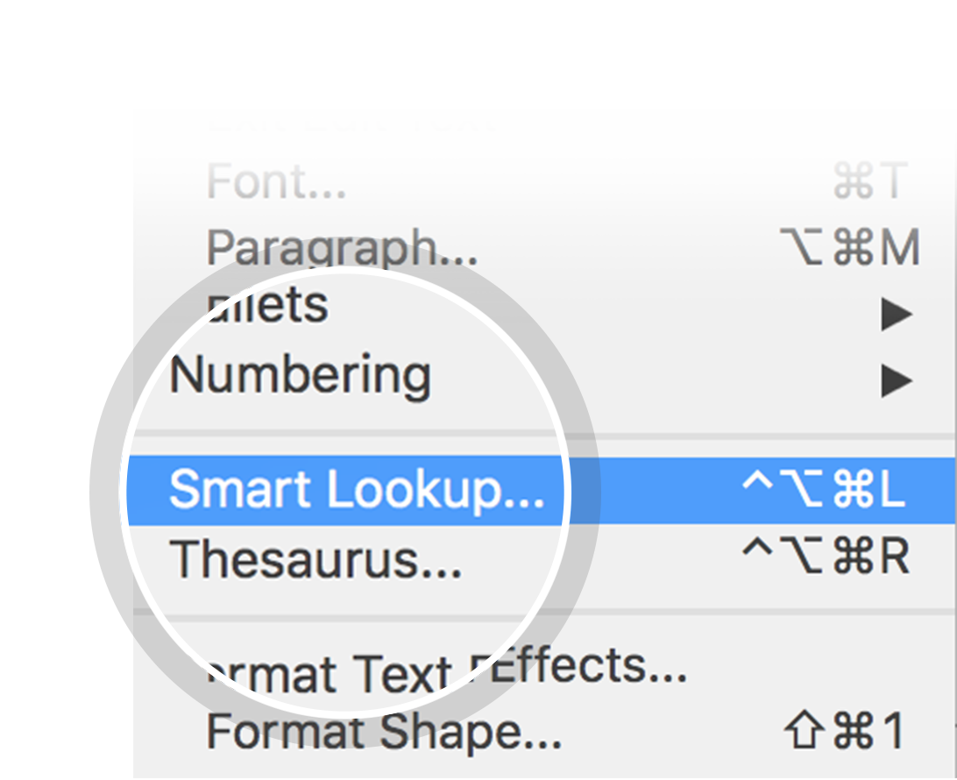
Related topics to research
Elections in the United States
United States midterm election
Donald Trump
Super Tuesday
Off-year Election
Thanksgiving
General Election
Public holidays in the United States
Primary Election
Use Smart Lookup to learn more
1
Highlight one of the related topics
Right-click on the topic
Choose "Smart Lookup"
2
3

Slide 3
Election 2020
What Worked & What Didn’t: Moving Forward

Slide 4
Contents
Voter Participation
Misinformation
Election Security
Election Protection Program

Slide 5
Voter Participation

Slide 6
Disinformation

Slide 7
Election Security

Slide 8
Election Protection Program

Slide 9
NM’s Election Protection Program

Slide 10
What’s Next?
Tribal Specific Legislation for address polling locations and increase/ensure access
Codify temporary election changes
Review and amend election code to address safety concerns (i.e. guns at the polls, increase electioneering boundaries)
Review and amend election codes to better address pandemic issues that arose on Election Day
Automatic Voter Registration (full compliance due by 2021)

